Slide 1
DSA 503
Estimation:
Point and Interval

Slide 2
Estimation: an introduction
Definition
The assignment of value(s) to a population parameter based on a value of the corresponding sample statistic is called estimation.

Slide 3

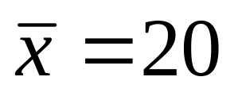
Estimation: an introduction
Definition
The sample statistic which is used to estimate a population parameter is called an estimator.
Example: Sample mean ( )
The value(s) of a sample statistic is called an estimate.
Example:

Slide 4
Properties of a Good Estimator
Unbiasedness
Mean square error (MSE)
Consistency
Minimum variance unbiased estimator (MVUE)
Note: The above topics will be discussed in class.

Slide 5
Properties of a Good Estimator
Unbiasedness: Any statistic (T) whose mathematical expectation is equal to a parameter θ is called an Unbiased estimator of θ i.e.
E(T)= θ.
Bias (T) = E(T)- θ.
The estimator T is asymptotically unbiased if “Bias” tends to zero for large sample.

Slide 6
Methods of finding estimators
Method of moments
Method of maximum likelihood
Method of least square
Note: These methods will be discussed in class.

Slide 7
Methods of finding point estimators
Method of moments
Method of maximum likelihood
Method of least square
Note: Theory will be discussed in class.

Slide 8
Types of Estimation
Point estimation: The process in which the value of a sample statistic is used to estimate a population parameter.
Interval estimation: An interval is constructed around the point estimate, and it is stated that this interval is likely to contain the corresponding population parameter.
Note: Theory will be discussed in class.

Slide 9
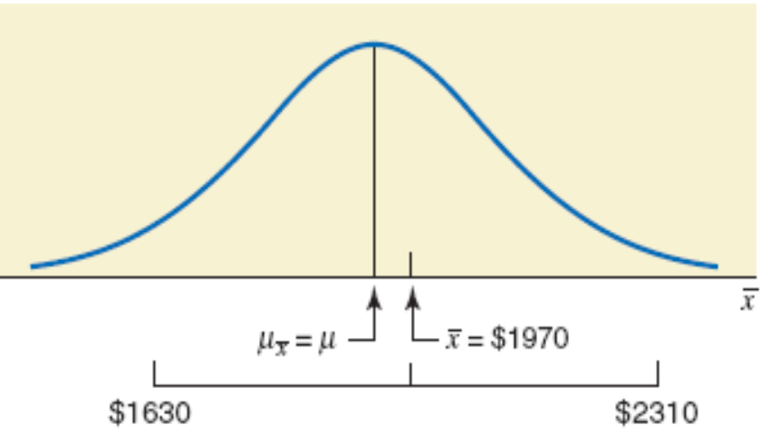
Figure: Interval Estimation

Slide 10
Confidence Level and Confidence Interval
Each interval is constructed with regard to a given confidence level and is called a confidence interval. The confidence level is given as
Point estimate ± Margin of error
The confidence level is denoted by
(1 – α)100%.

Slide 11

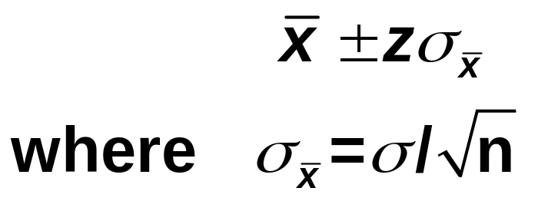
Estimation of Population Mean: σ known
Point estimate of μ is .
Confidence Interval for μ: The (1 – α)100% confidence interval for μ is
The value of z is obtained from the standard normal distribution table for the given confidence level.

Slide 12
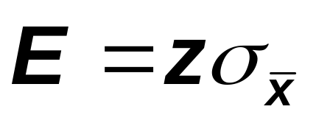
Estimation of Population Mean: σ known
Definition
The margin of error for the estimate of μ, denoted by E,

Slide 13
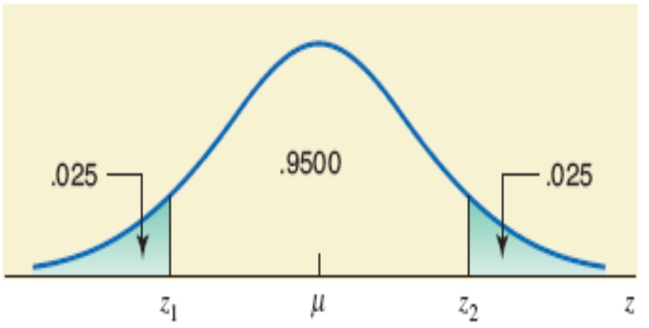
Finding z for a 95% confidence level

Slide 14
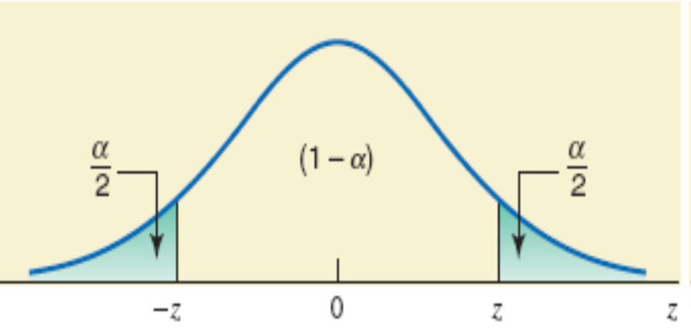
Figure: Area in tails

Slide 15
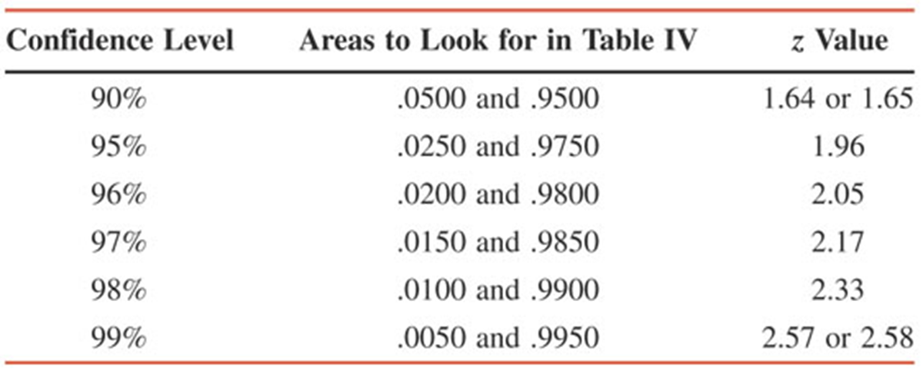
z Values for Commonly Used Confidence Levels

Slide 16
Example
A publishing company has just published a new college textbook. Before the company decides the price at which to sell this textbook, it wants to know the average price of all such textbooks in the market. The research department at the company took a sample of 25 comparable textbooks and collected information on their prices. This information produces a mean price of $145 for this sample. It is known that the standard deviation of the prices of all such textbooks is $35 and the population of such prices is normal.

Slide 17
Example
What is the point estimate of the mean price of all such textbooks?
Construct a 90% confidence interval for the mean price of all such college textbooks.
Write down the margin of error.

Slide 18
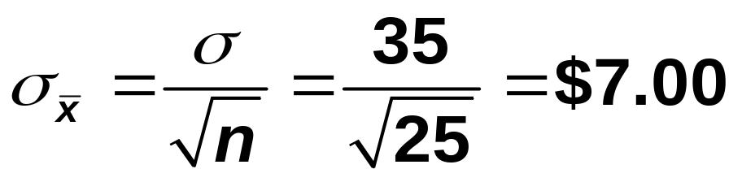
Example: Solution
n = 25, = $145, and σ = $35
Answer: Point estimate of μ is = $145

Slide 19
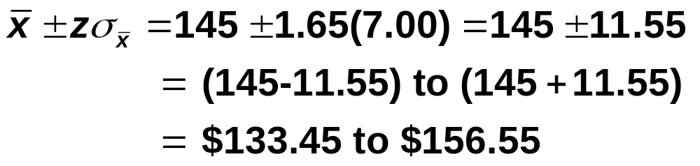
Example: Solution
(b) Confidence level is 90% or 0.90.
z = 1.65.
We can say that we are 90% confident that the mean price of all such college textbooks is between $133.45 and $156.55.
(c) Margin of error is 11.55.

Slide 20
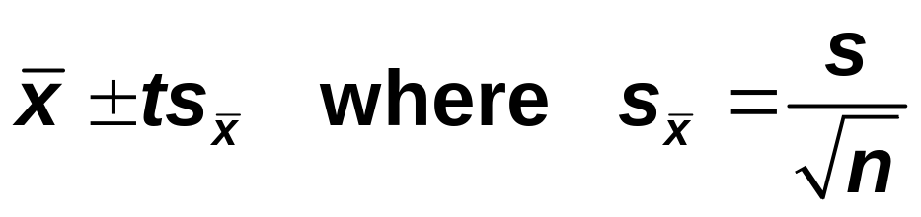
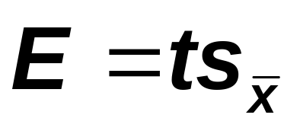
Estimation of Population Mean: σ unknown
Confidence Interval for μ: The (1 – α)100% confidence interval for μ is
The value of t is obtained from the t distribution table for the given confidence level.
Margin of error of the estimate is:

Slide 21
Example
Dr. Moore wanted to estimate the mean cholesterol level for all adult men living in Hartford. He took a sample of 25 adult men from Hartford and found that the mean cholesterol level for this sample is 186 mg/dL with a standard deviation of 12 mg/dL. Assume that the cholesterol levels for all adult men in Hartford are (approximately) normally distributed. Construct a 95% confidence interval for the population mean μ.

Slide 22
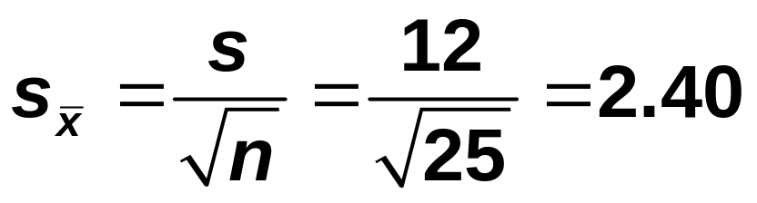
Solution
σ is not known and the population is normally distributed.
Use the t distribution to make a confidence interval for μ
Here
df = n – 1 = 25 – 1 = 24
The value of t is 2.064.

Slide 23
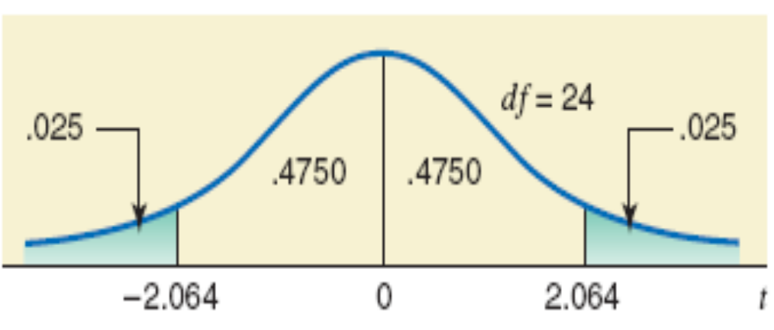
Solution
df = n – 1 = 25 – 1 = 24
The value of t is 2.064.

Slide 24
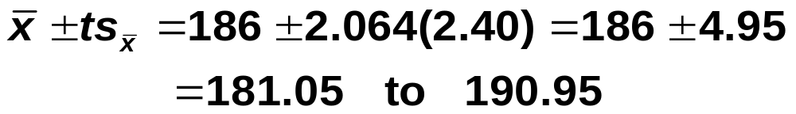
Solution
Thus, we can state with 95% confidence that the mean cholesterol level for all adult men living in Harford lies between 181.05 and 190.95 mg/dL.

Slide 25

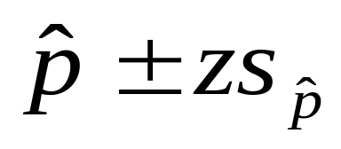
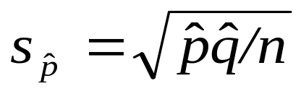
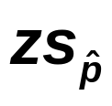
Estimation of population proportion (p): large samples
Point estimate of p is .
The (1 – α)100% confidence interval of p is
where
Note: The value of z used here is obtained from the standard normal distribution table for the given confidence level.
The margin of error, E is:

Slide 26
Example
According to a survey by Pew Research Center in June 2009, 44% of people aged 18 to 29 years said that religion is very important to them. Suppose this result is based on a sample of 1000 people aged 18 to 29 years.

Slide 27
Example
What is the point estimate of the population proportion?
Find, with a 99% confidence level, the percentage of all people aged 18 to 29 years who will say that religion is very important to them.
What is the margin of error of this estimate?

Slide 28

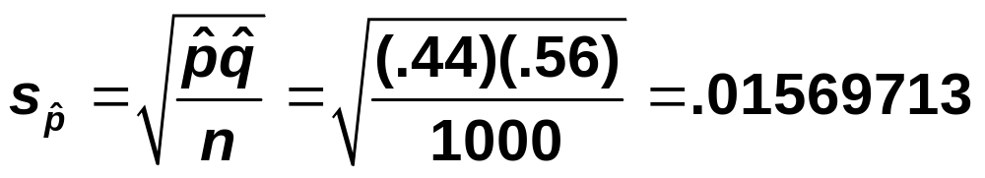

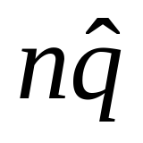
Solution
n = 1000, = 0.44, and, = 0.56
Note that and are both greater than 5.
Point estimate of p is = 0.44

Slide 29
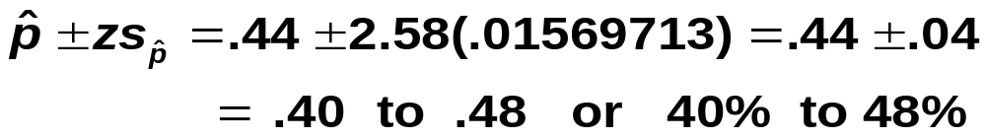
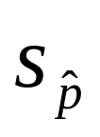
The confidence level is 99%, or .99. z = 2.58.
Interpretation: Home Work
c) Margin of error is Z = 2.58(.01569713)
= .04

Slide 30
Example
According to a Harris Interactive survey of 2401 adults conducted in April 2009, 25% of adults do not drink alcohol.
i) What is the point estimate of the population proportion?
ii) Construct a 97% confidence interval for the corresponding population proportion.
iii) Margin of error?

Slide 31
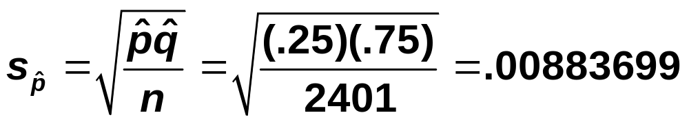
Solution
Confidence level = 97% or .97
The value of z for 97% confidence level is 2.17.

Slide 32
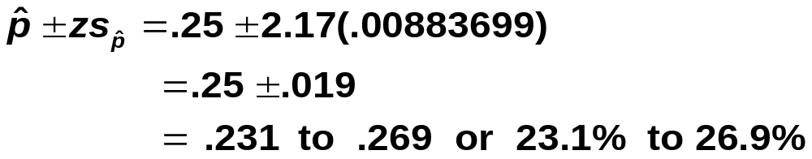
Solution
(i) Point estimate of p is =.25
(ii) 97% confidence interval for the population proportion is
HW: Interpretation
…………………

